Slide 1

2D Point Classification Example
Professor Bo Liu
James Watt School of Engineering

Slide 2
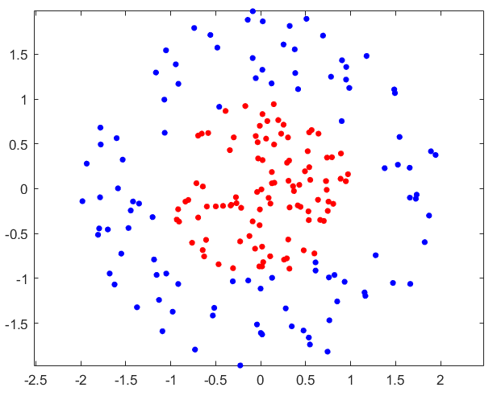
Nonlinear SVM – 2D point classification
A simple example for illustrative purpose.
We generate the data by the following code.
rng(1); % For reproducibility
r = sqrt(rand(100,1)); % Radius
t = 2*pi*rand(100,1); % Angle
data1 = [r.*cos(t), r.*sin(t)]; % Points
r2 = sqrt(3*rand(100,1)+1); % Radius
t2 = 2*pi*rand(100,1); % Angle
data2 = [r2.*cos(t2), r2.*sin(t2)]; % points
figure;
plot(data1(:,1),data1(:,2),'r.','MarkerSize',15)
hold on
plot(data2(:,1),data2(:,2),'b.','MarkerSize',15)
axis equal
hold off;
See live script

Slide 3
Nonlinear SVM – 2D point classification
1. Create our dataset
X = [data1;data2]; % Features of the dataset
% Labels of the dataset. The first 100 data are +1, the rest are -1.
y = ones(200,1); y(1:100) = -1;
2. Data split
% Split into training and test data by the ratio 75% and 25%, respectively.
cvObj = cvpartition(size(X, 1), 'HoldOut', 0.75);
idx = cvObj.test;
X_train = X(idx, :); X_test = X(~idx, :);
y_train = y(idx, :); y_test = y(~idx, :);
3. Train a nonlinear SVM classifier by RBF kernel
%Train a nonlinear SVM Classifier with 'rbf' kernel
svm = fitcsvm(X_train,y_train,'KernelFunction','rbf', 'BoxConstraint', 1);
See live script

Slide 4
Nonlinear SVM – 2D point classification
4. Prediction
% Predict
y_pred = predict(svm, X_test);
accuracy_score = sum(y_test == y_pred)/length(y_test)*100; % Prediction accuracy
disp(['Accuracy: ', num2str(accuracy_score)]);
We will get ‘Accuracy=100’ in this example.
5. Plot the data and the support vectors
% Plot the data and the support vectors
figure;
gscatter(X_train(:,1),X_train(:,2),y_train,'rb','.'); hold on; % Plot the data
sv = svm.SupportVectors;
plot(sv(:,1), sv(:,2), 'ko', 'MarkerSize', 10); hold on; % Plot the support vectors
See live script

Slide 5
Nonlinear SVM – 2D point classification
6. Plot the classifier (optional)
% Plot the classifier (optional)
d = 0.02;
[x1, x2] = meshgrid(min(X_train(:,1)):d:max(X_train(:,1)), min(X_train(:,2)):d:max(X_train(:,2)));
XGrid = [x1(:),x2(:)];
yGrid = predict(svm, XGrid);
contour(x1, x2, reshape(yGrid,size(x1)), [0 0], 'g'); hold on;
legend('-1','+1','Support Vectors', 'Classifier', 'Fontsize', 14);
axis equal; hold off;
We do not plot the classifier and the support vectors in most cases, since that:
in practice, the dimension of the feature spaces is often much larger than 3, which is unable to plot.
See live script

Slide 6
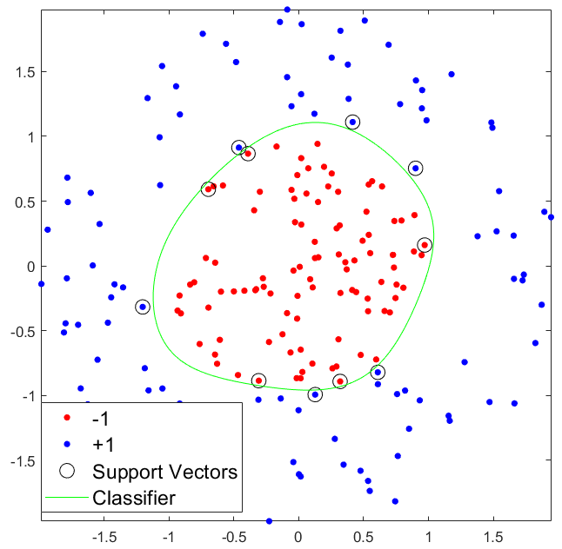
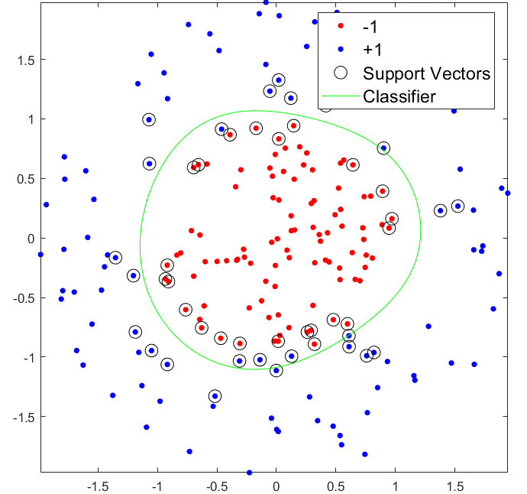

Nonlinear SVM – 2D point classification
The results
BoxConstraint = $∞$
BoxConstraint = 1
The BoxConstraint parameter has the same effect as that in the linear case.
See live script

Slide 7




Thanks!
#UofGWorldChangers
@UofGlasgow

